Slide 1
Zooplankton Elemental Composition in the Amazon River Plume Region
1

Slide 2


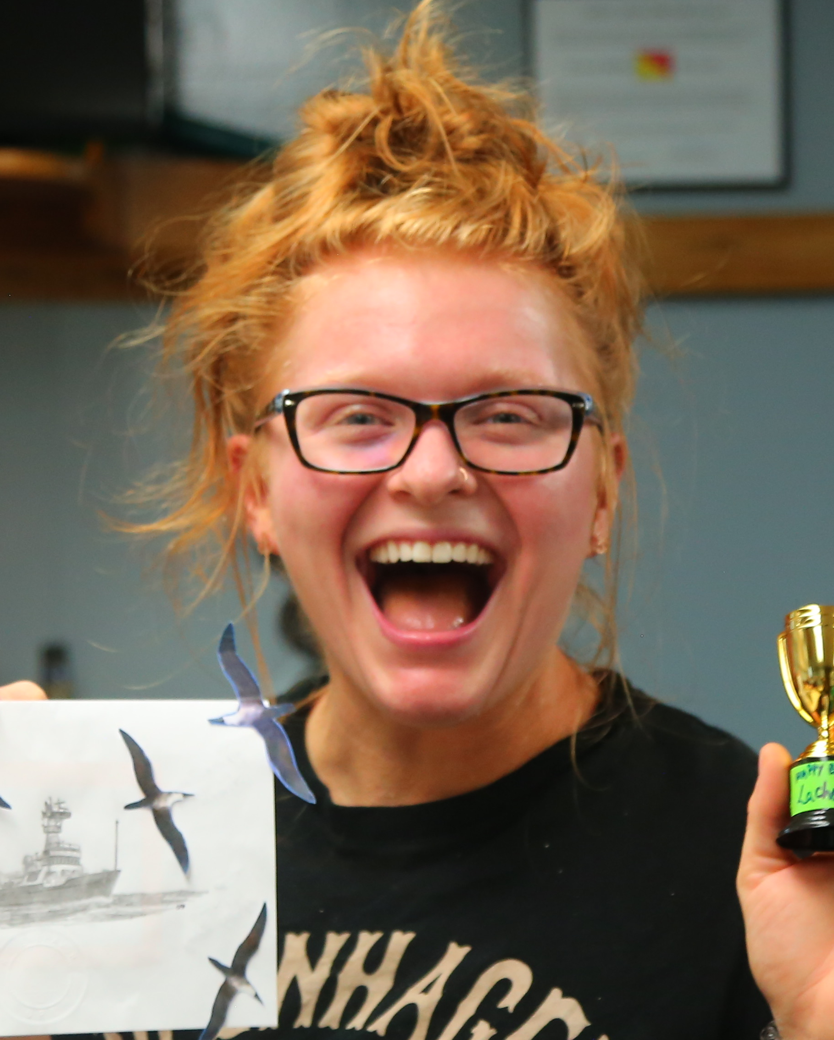

Grace Davenport
Erica Strope
Joe Montoya
REU Student
Department of Biology
James Madison
Research Tech
School of Biological Sciences
Georgia Tech
Professor
School of Biological Sciences
Georgia Tech
2

Slide 3
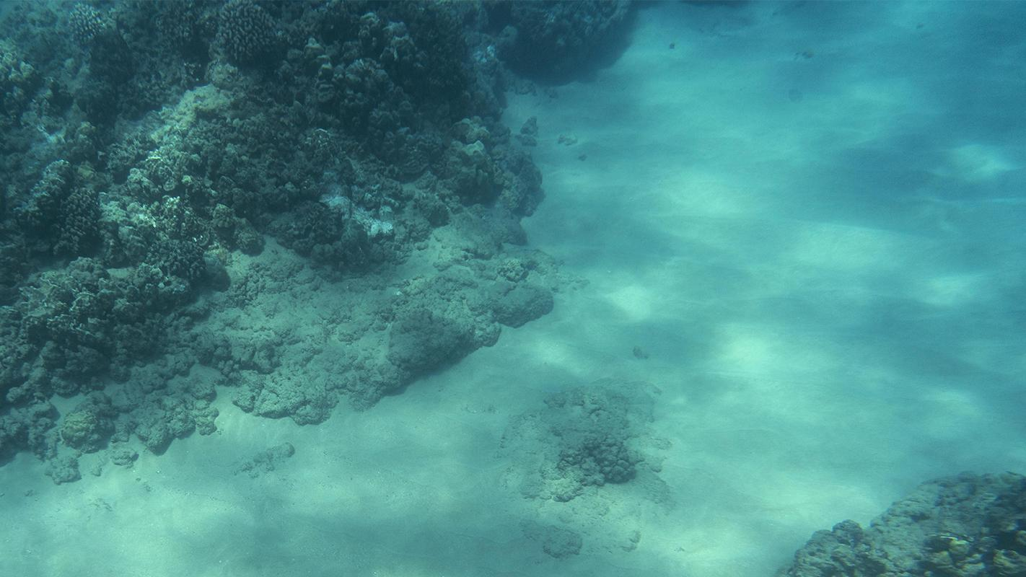
Background
3

Slide 4
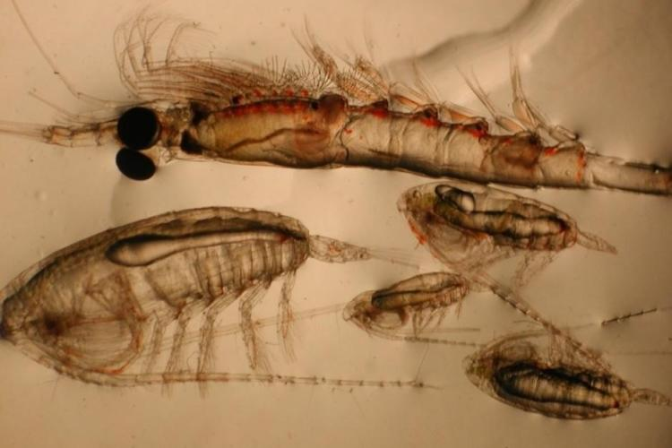
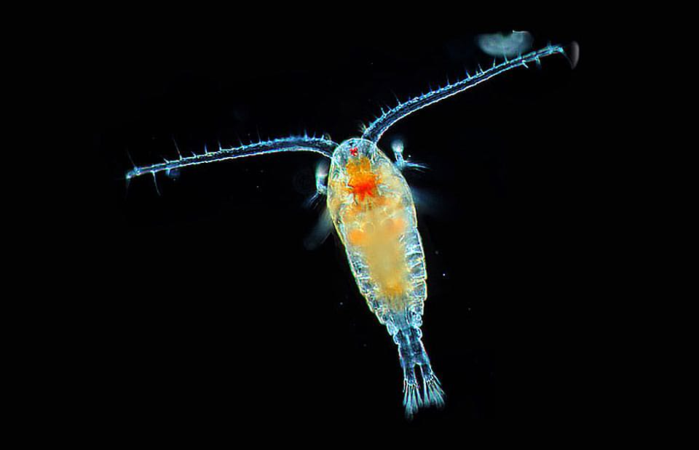
Zooplankton
zoo
+
plankton
animal
drifter
Primary + secondary consumers
4
Notes:
Zoo = animal, plankton = drifter
(all plankton) Cannot swim against ocean current
Primary/ secondary consumers
Feed on phytoplankton (primary producers)

Slide 5
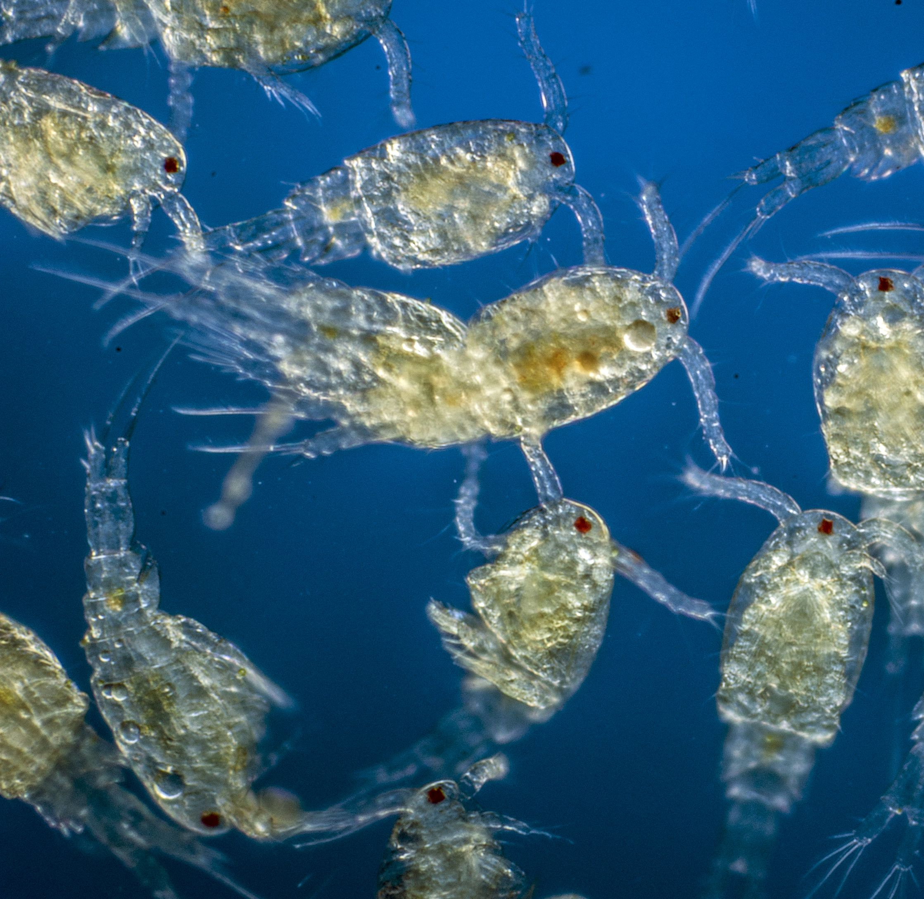
Carbon:
organic matter
Nitrogen:
proteins
nucleic acid
Phosphorus:
nucleic acid
lipids
zooplankton
5
Notes:
Why do organisms need N or P or C?
Elemental composition (including P)
Redfield ratio
Zooplankton requirements

Slide 6
The Redfield Ratio
6
Notes:
“Zooplankton uptake these nutrients at generally at a ratio, known as the Redfield ratio. Studying these ratios in zooplankton can elucidate nutrient limitations …”

Slide 7
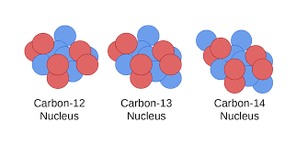
Isotopes
Carbon 12
Carbon 13
7
Notes:
Add equation -> overtop of these images
Same atomic number
Different atomic mass
Types:
Stable 15N and 13C
Unstable 14C
Because of this phenomenon we can use isotopes to ….
track sources of N
animal trophic position

Slide 8
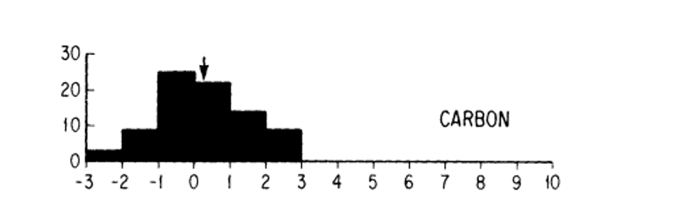
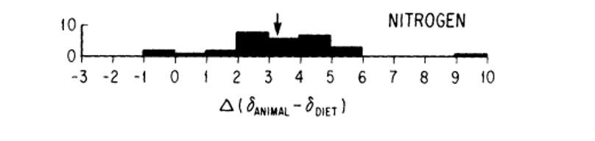
Carbon: Animals slightly enriched in (+) ¹³C by 0.2‰
Nitrogen: Animals enriched (+) in ¹⁵N by 3.2‰
Peterson and Fry (1987)
9

Slide 9
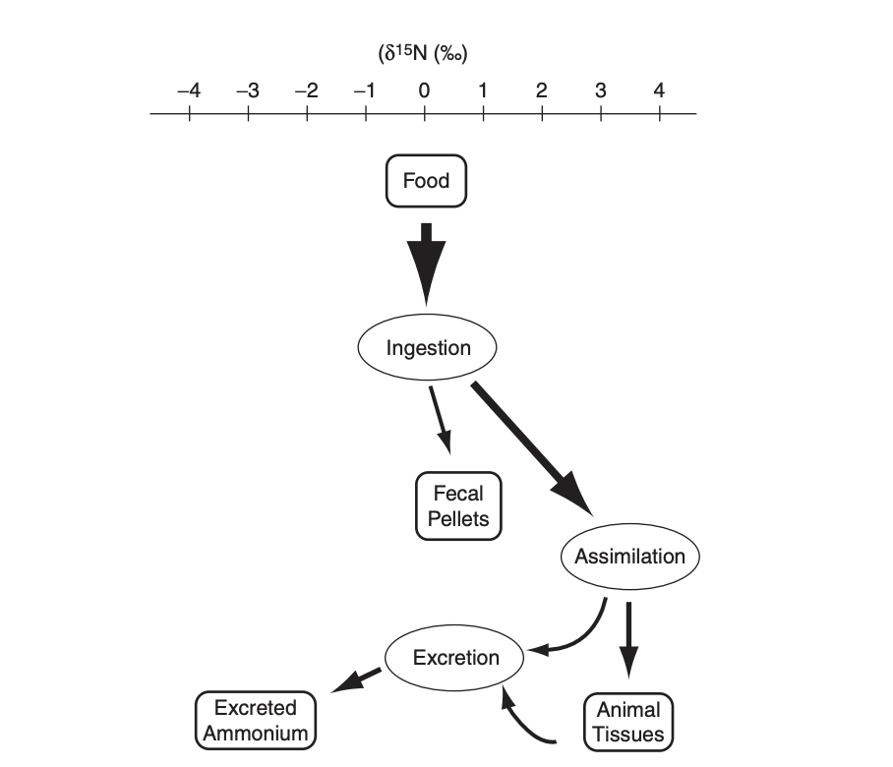
δ¹⁵N can:
track trophic position
reflect food source’s N
8

Slide 10
Methodology
10

Slide 11
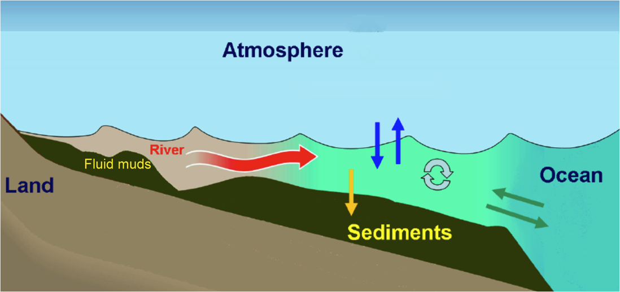
Tropical River Plumes
Connect land and sea
Transport nutrients
Stimulate primary production
11
Notes:
Talk about Amazon River Plume
The mouth of the amazon dumps fresh water into the WTNA
Western Tropical North Atlantic
4 that were sampled (there are 7 total)

Slide 12
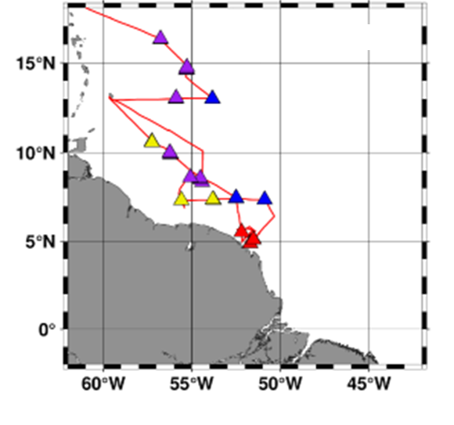
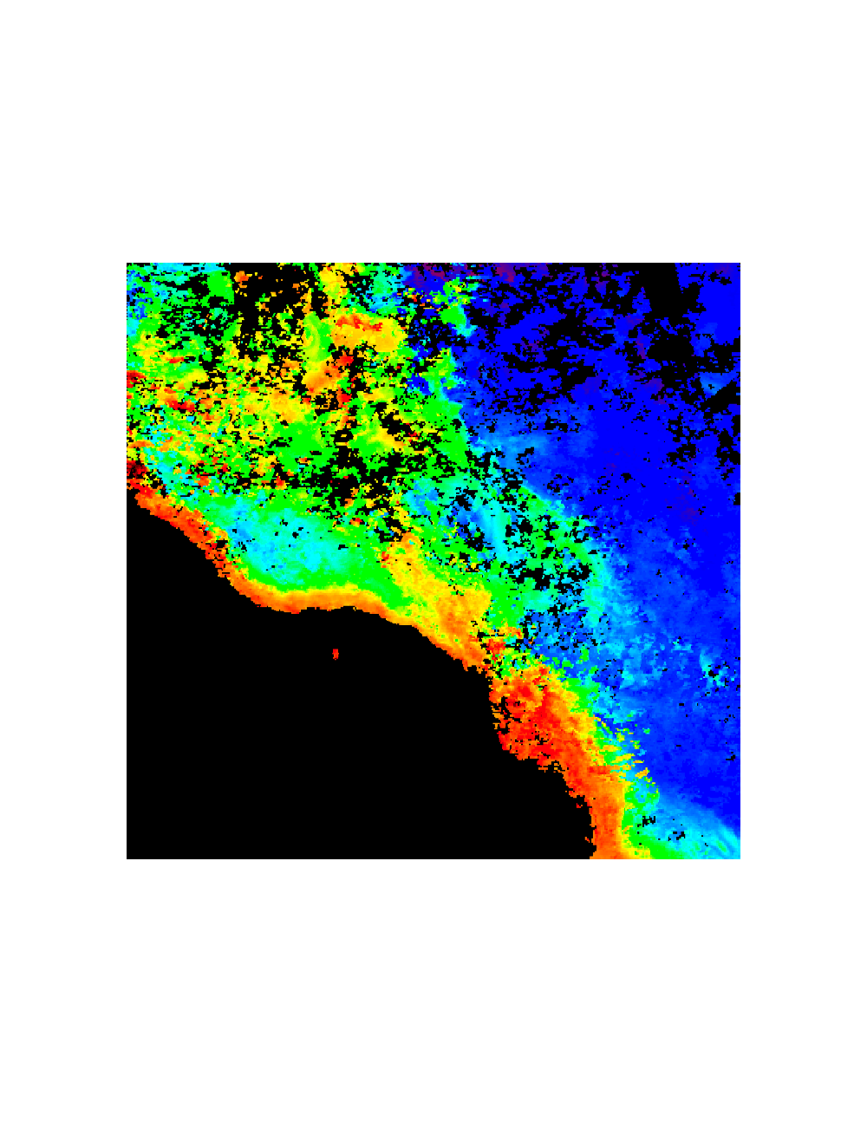
Amazon River Plume
Pham et al. (in prep)
Weber et al. (2017)
Amazon
River Mouth
Young Plume Core Western Plume Margin Outer Plume Margin Oceanic Water
12
Notes:
*add statile image and put habitats underneath
Talk about Amazon River Plume
The mouth of the amazon dumps fresh water into the WTNA
Western Tropical North Atlantic
4 that were sampled (there are 7 total)

Slide 13
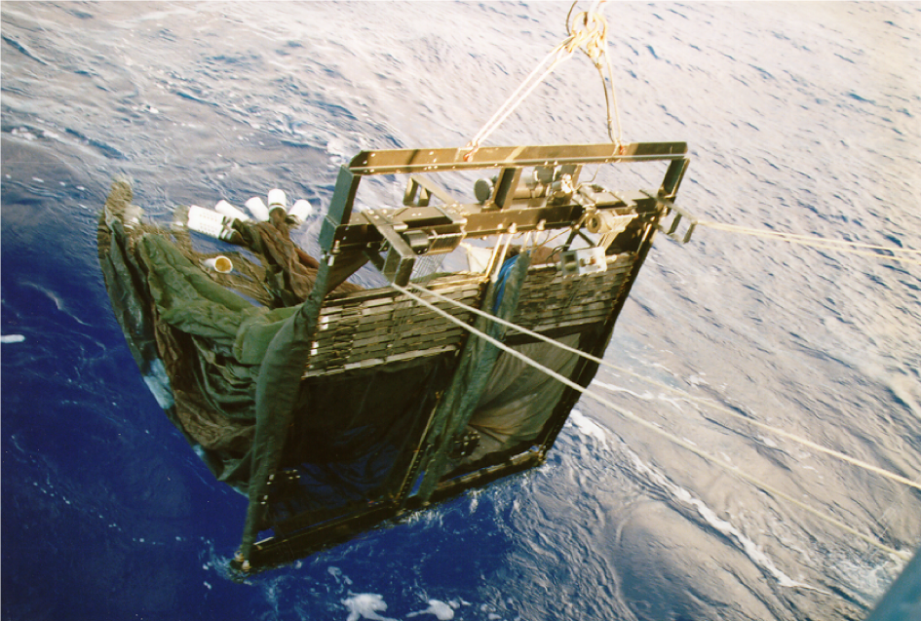
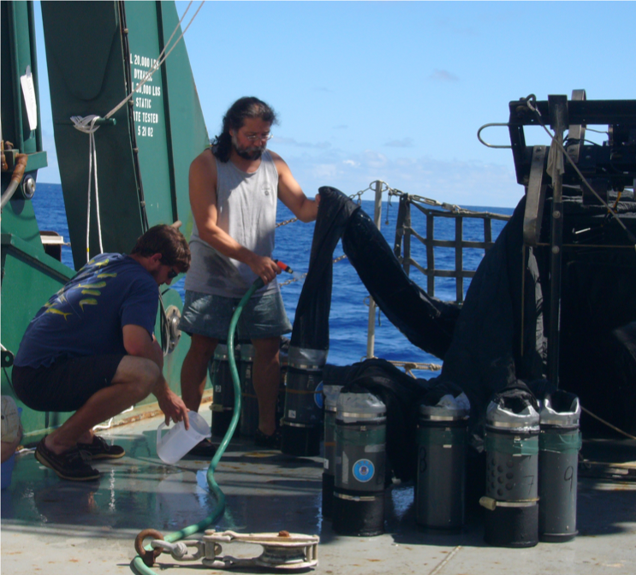
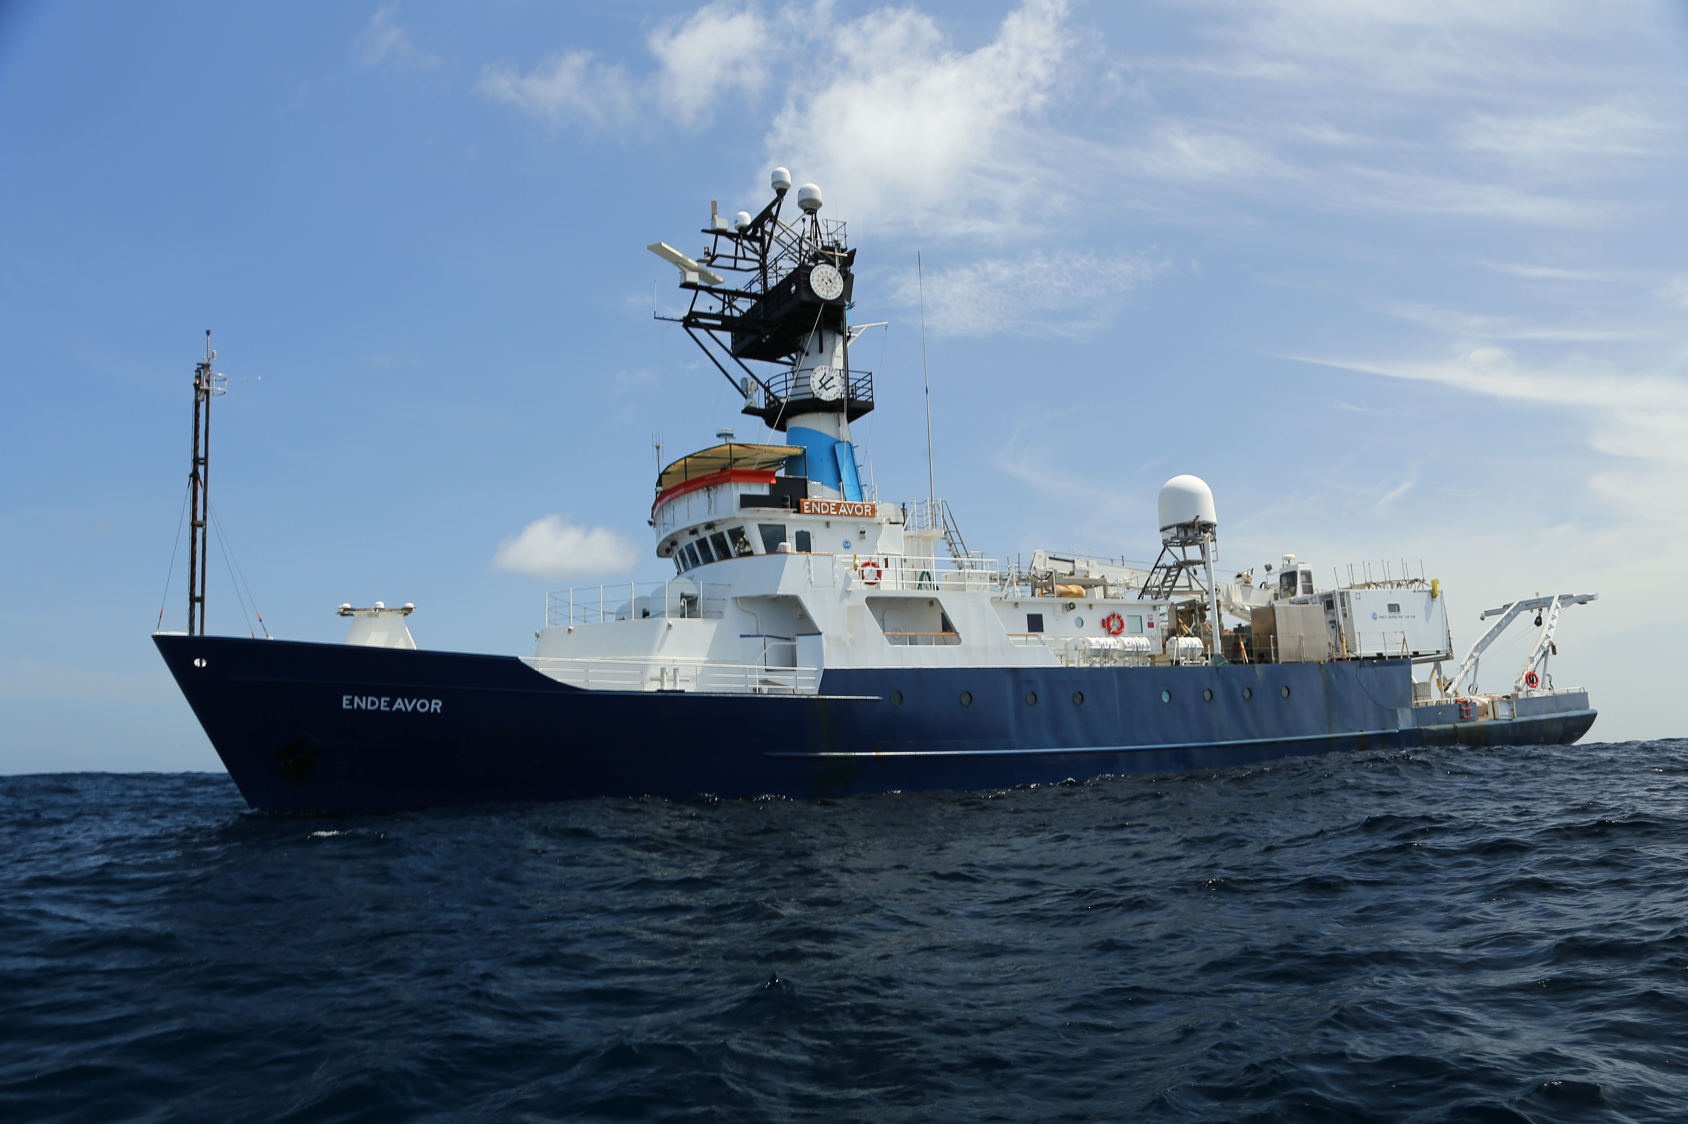
Cruise EN614
6 May – 1 June 2018
*Insert picture of ship
13
Notes:
Collected samples using either a meter net of a MOCNESS (Multiple Opening-Closing Net and Environmental Sensing System)
Samples were separated into five size fractions (250, 500, 1000, 2000, 4000 µm) using a nitex sieve

Slide 14
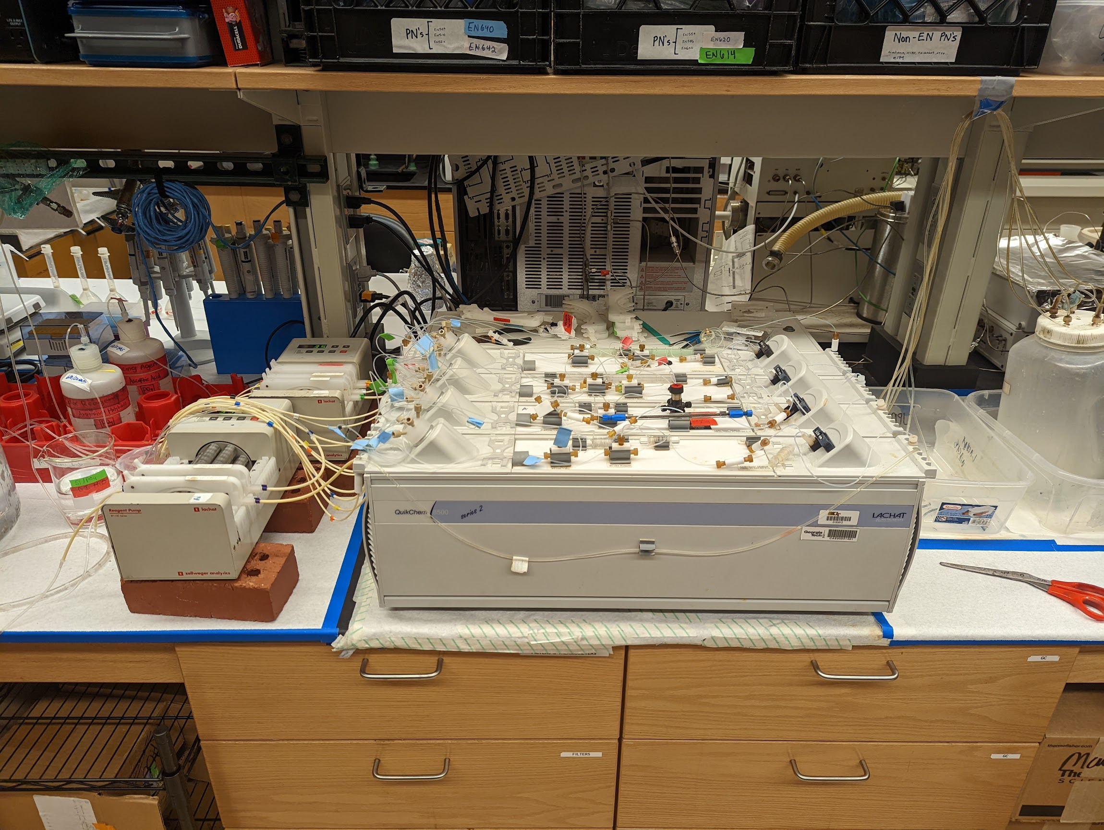
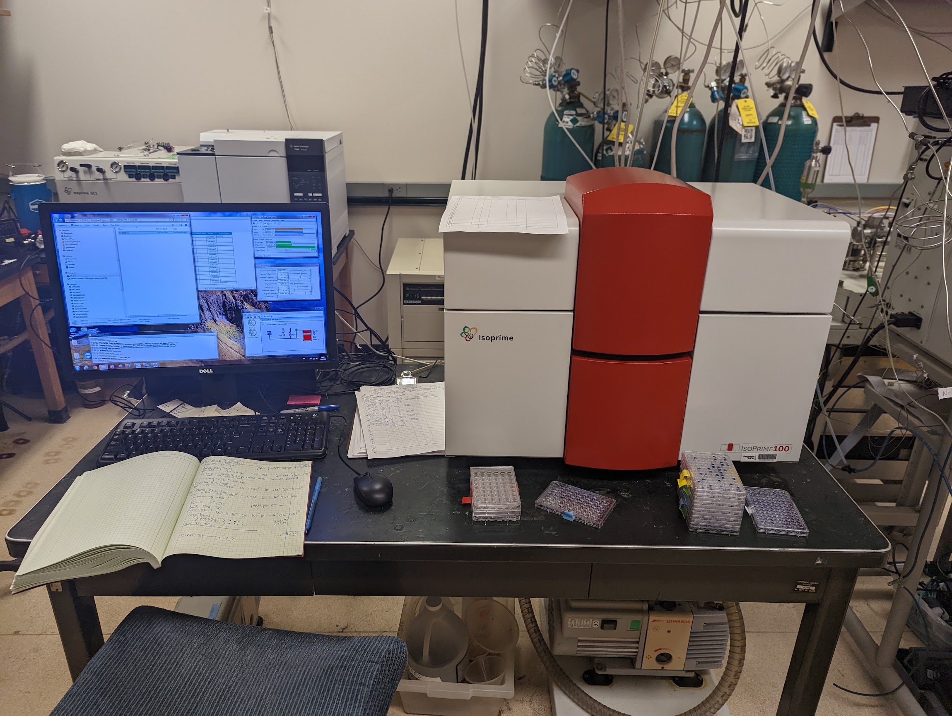
Total Dissolved P
Content
C and N Content
δ¹³C and δ¹⁵N
Lachat Quikchem 8500
Continuous-flow Isotope Ratio
Mass Spectrometer (CF-IRMS)
16

Slide 15
Results
17

Slide 16
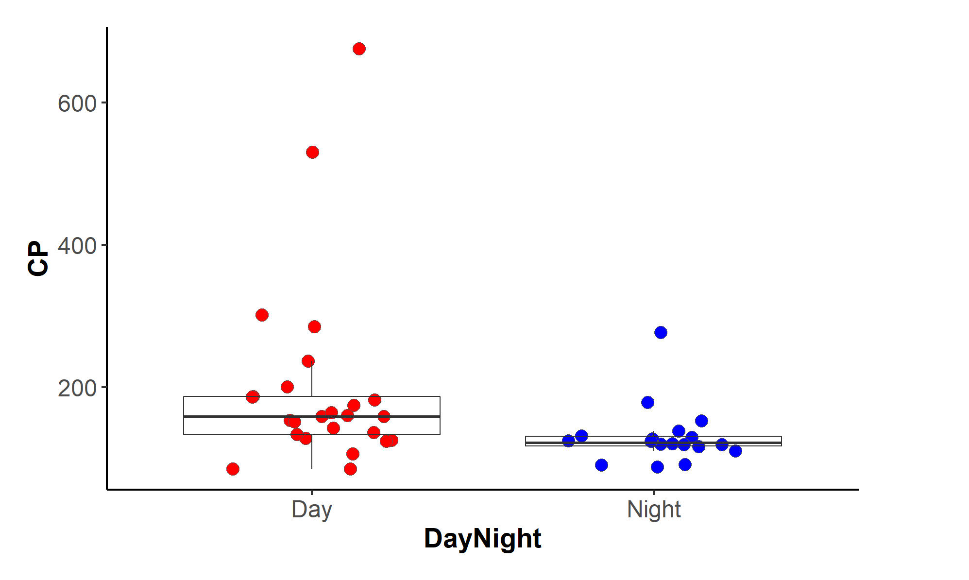
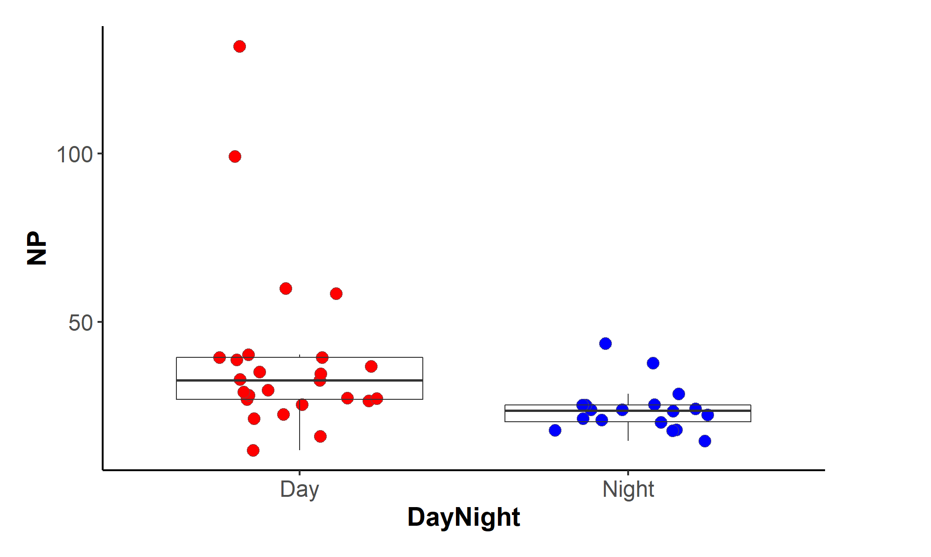
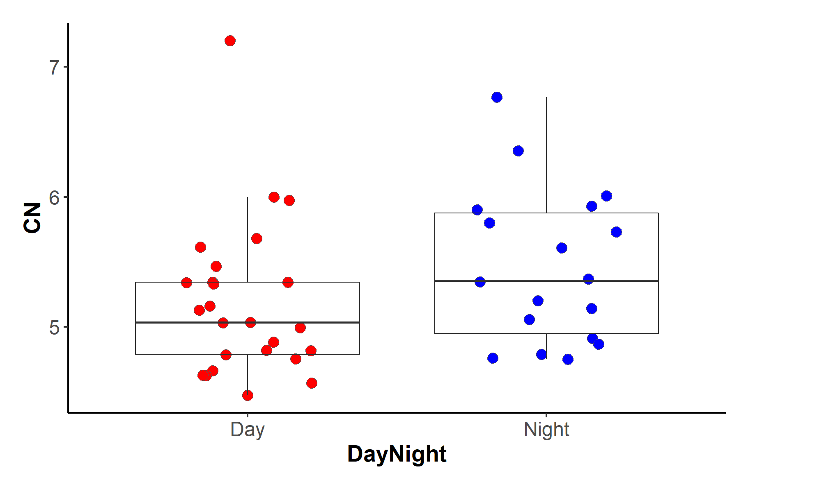
C:P
N:P
Day Night
Day Night
Kruskal Wallis (p=0.005**)
Kruskal Wallis (p=0.002**)
C:N
Day Night
Kruskal Wallis (p=0.089)
18

Slide 17
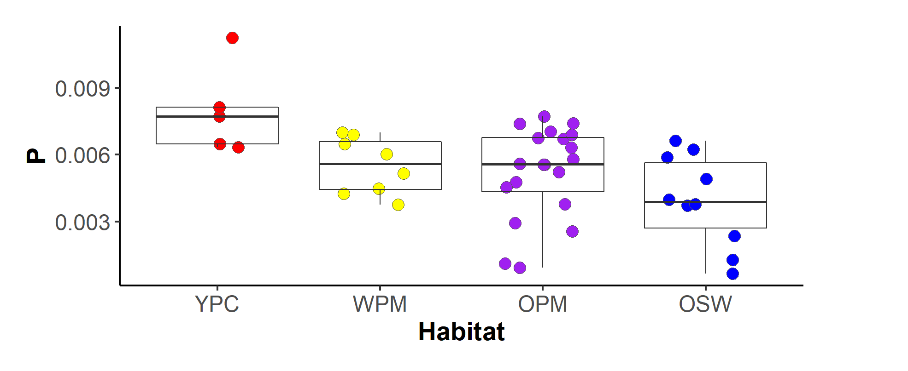
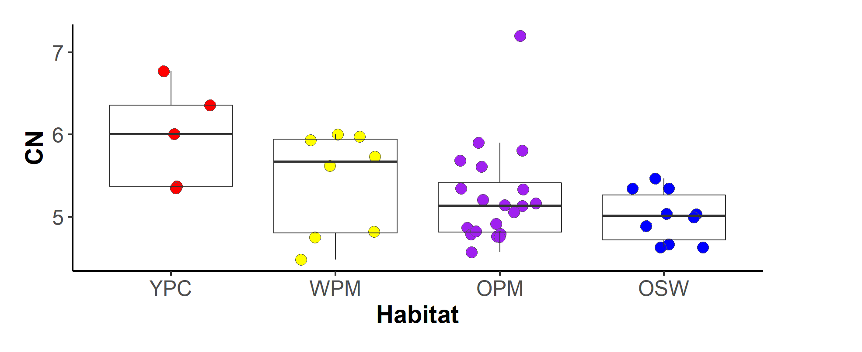
a
ac
bc
bc
P Content (g/g)
anova (p=0.005**)
a
a
a
b
anova (p=0.032**)
19

Slide 18
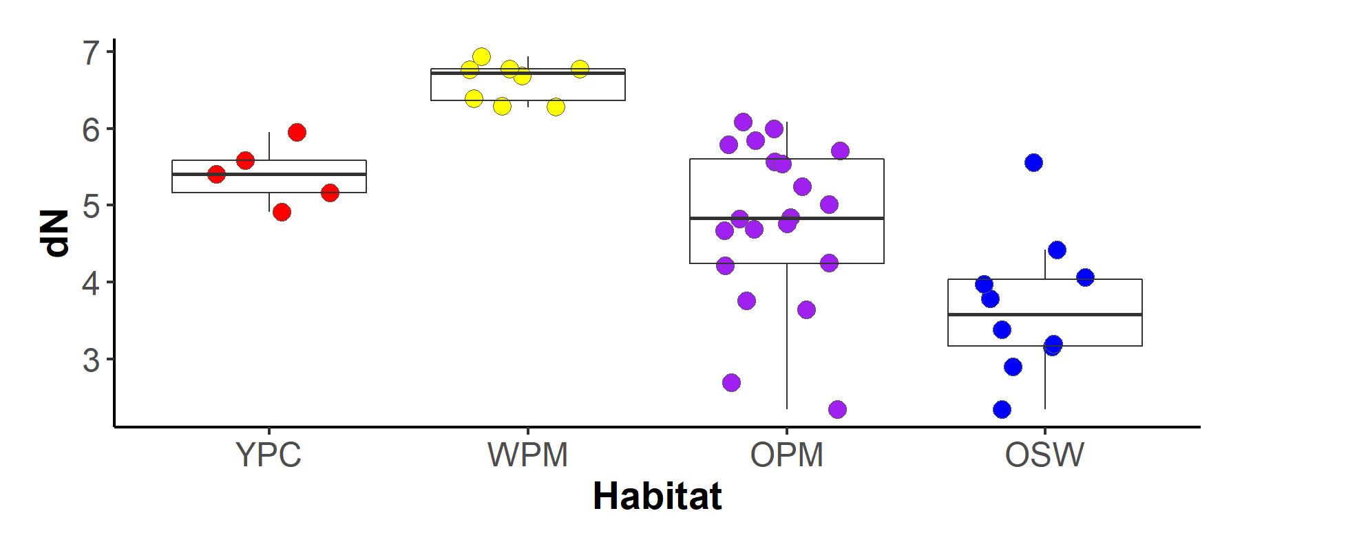
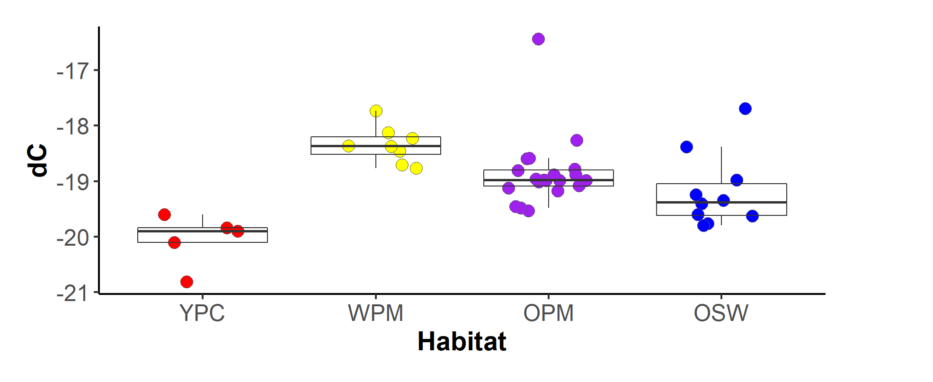
a
ab
ac
d
δ¹⁵N(‰)
anova (p=1.6e-07**)
a
b
bc
ac
δ¹³C(‰)
anova (p=5.32e-05**)

Slide 19
Conclusion
20

Slide 20
Key Takeaways
C:P and N:P lower at night
Non-migratory zooplankton (day) are limited by P
C:N decreases as plume influence decreases
YPC most N stressed (no diazotrophs)
δ¹³C peak in WPM
Uptake of varying cell sizes (large cells = ↑ δ¹³C)
δ¹⁵N peak in WPM
Lag incorporating low δ¹⁵N values (from diazotrophs)
21

Slide 21


Acknowledgments
Dr. Joseph Montoya
Erica Strope (Ph.D Student)
Anh Pham (Ph.D Candidate)
ACE REU
OCE-1737078
OCE-1851723
Notes:
Redfield stoichiometry (focus on elemental composition)
Put in (delta) equation

